Slide 1

Improving policy through better,
more timely agrifood systems data
Prof. Christopher B. Barrett
Cornell University
Ninth International Conference on Agricultural Statistics
Washington, DC
May 19, 2023

Slide 2
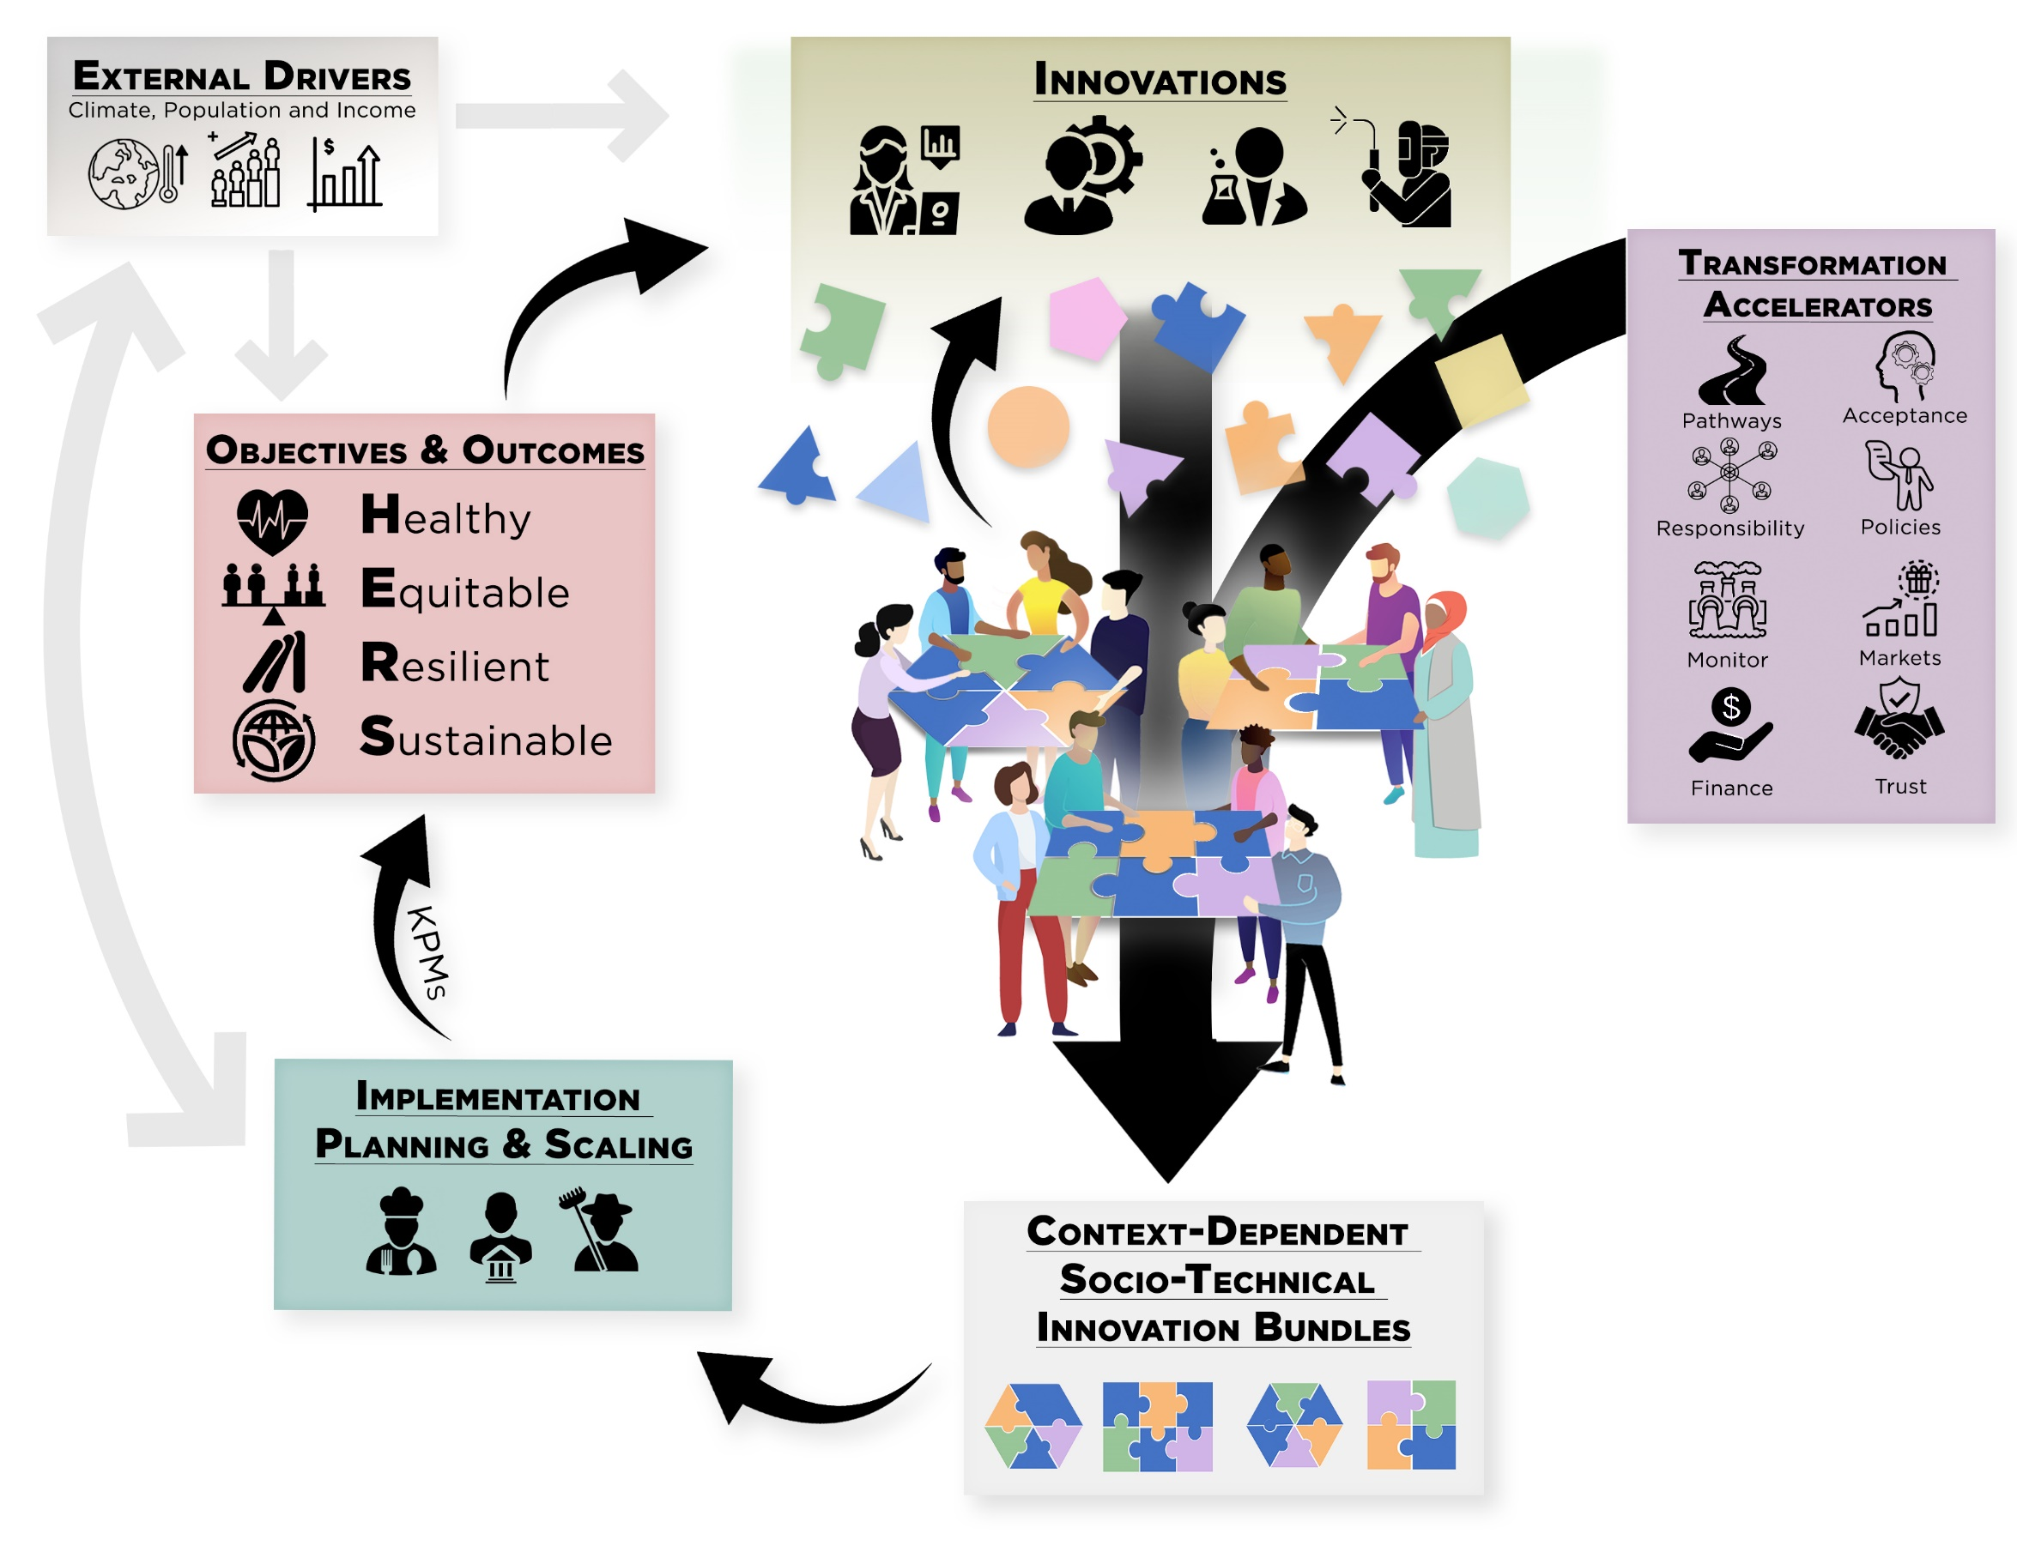
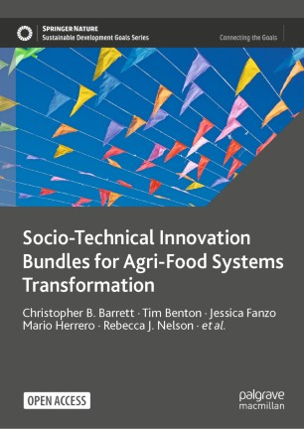
The pressing need for AFS transformation
The world increasingly recognizes the need to transform agrifood systems to simultaneously advance productivity, livelihoods, nutrition, health and other human welfare-oriented goals while safeguarding the natural systems on which AFS depend.
Multi-objective policymaking in complex systems requires high-quality, timely data and advanced analytical capabilities.

Slide 3
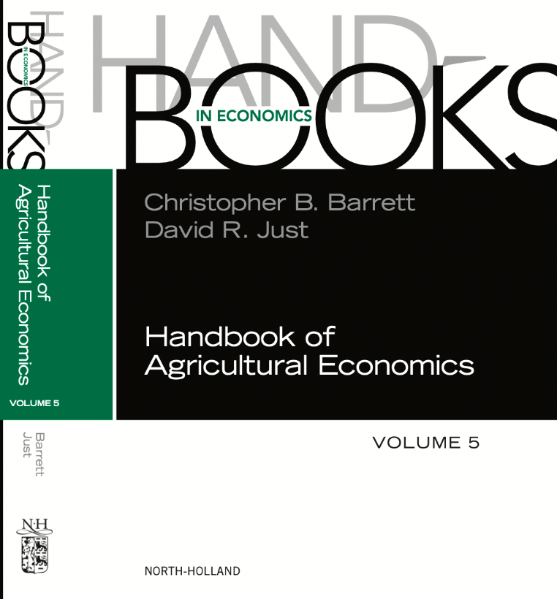
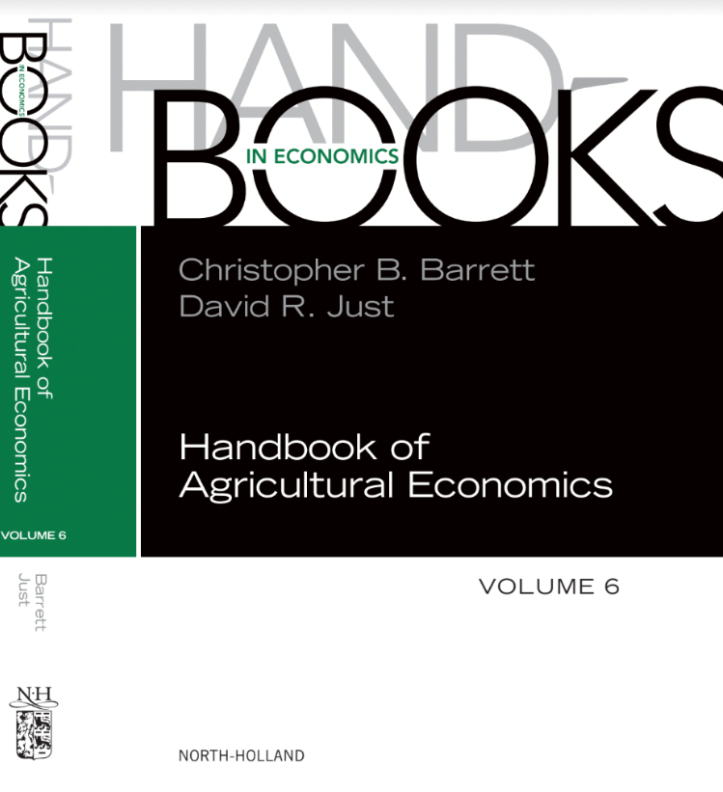
Agricultural economics renaissance
Agricultural economics has always been among the most empirical subfields of economics. ICT advances fueled progress in data methods and uses. Many described in volumes 5 (2021) and 6 (2022) of the Handbook of Agricultural Economics. It’s an exciting time in ag econ, with improved toolkits and heightened policy relevance.

Slide 4
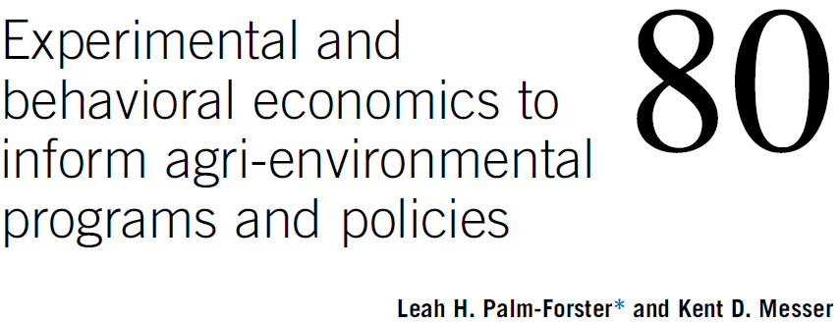
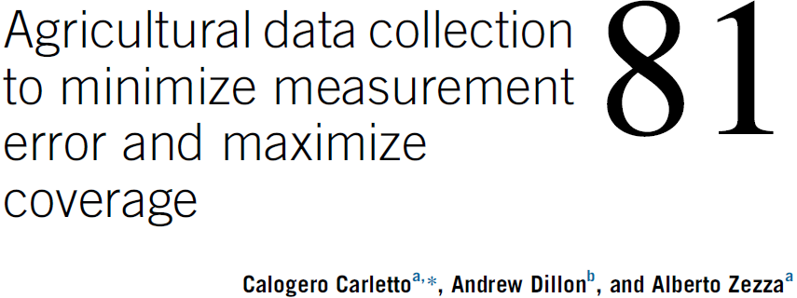
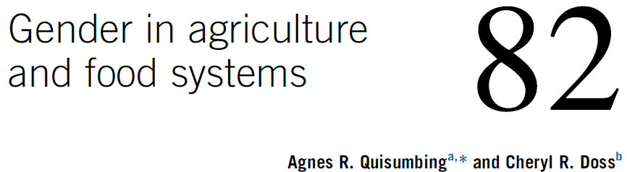
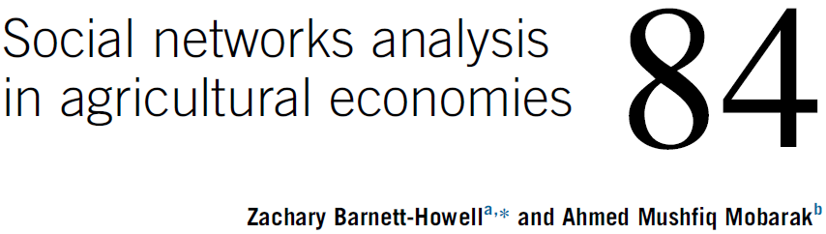
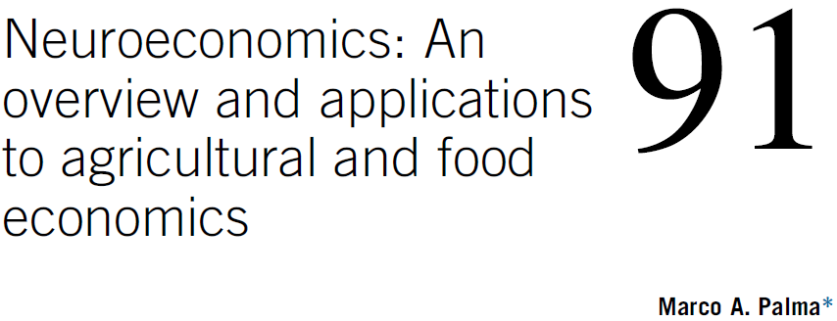
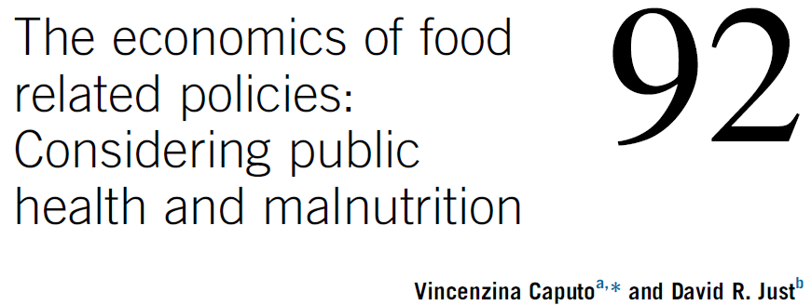
Agricultural economics renaissance
Significant advances have occurred in household, intra-household, neurophysiological and social networks data collection using a wide variety of methods, and in designing/implementing experiments to understand the causal effects of policies and programs.

Slide 5
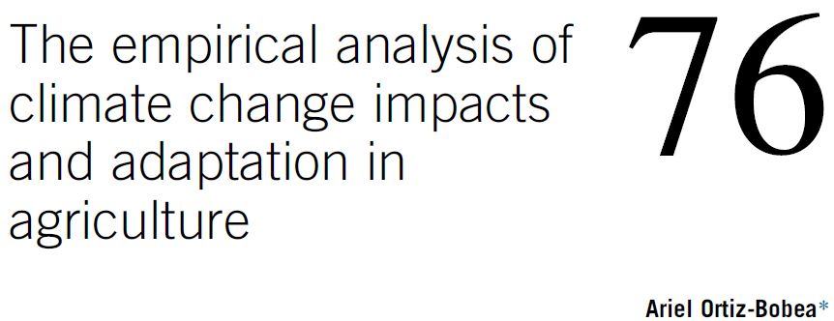
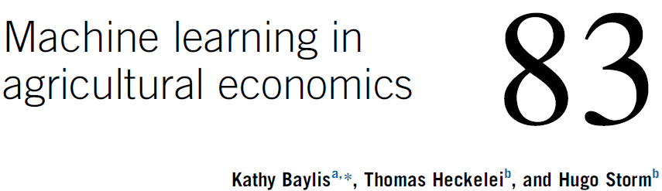
Agricultural economics renaissance
Similar advances have occurred in using climate data and modern data science methods (e.g., machine learning) to analyze large, complex data sets. Such data now underpin early warning systems, agricultural index insurance, land use monitoring (and some PES systems), and many program/policy M&E efforts.

Slide 6
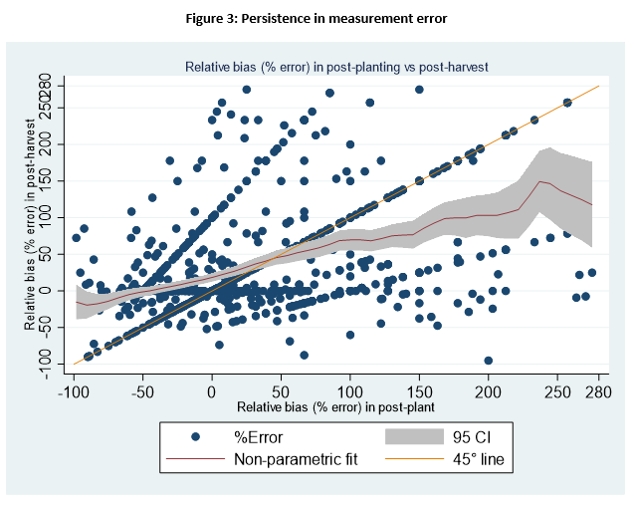
But how to understand measurement error?
But all data contain error. Economists still struggle with managing/ interpreting measurement error. Is it misreporting (i.e., noise that biases estimates) or is it misperceptions (i.e., reflects human errors in judgement)? The nature of (NC)ME has significant implications for how people learn, how we communicate info, and policy.
Example: experiment in Malawi
- 3% farmers accurately report plot size; only 13% post-info treatment.
- plurality (37%) don’t change incorrect beliefs.
- ME larger post-treatment for 23%!
(Abay et al. in review)

Slide 7
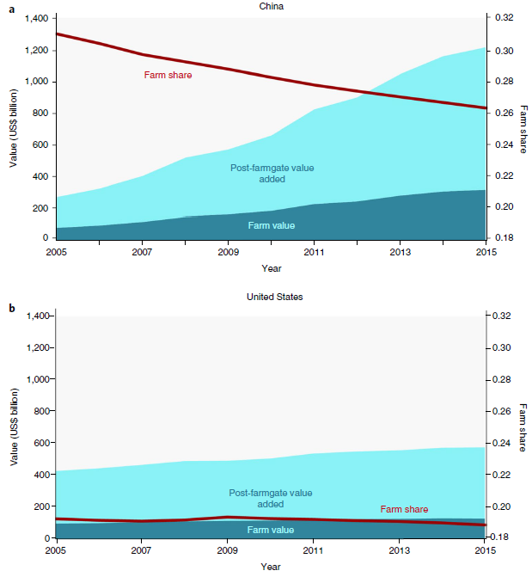
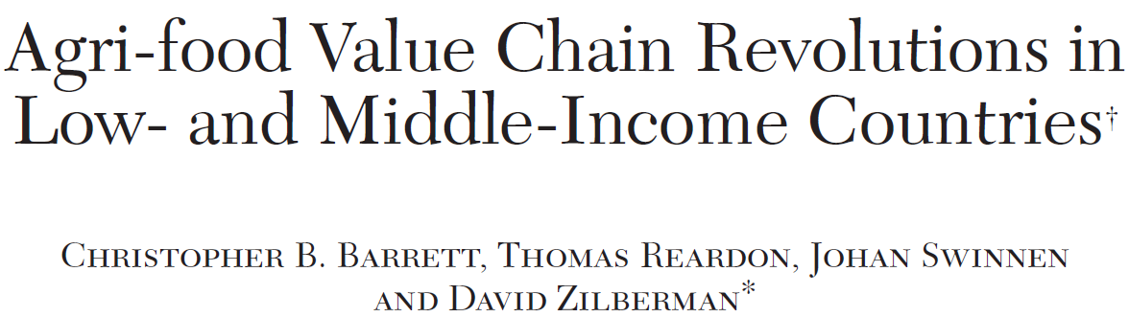
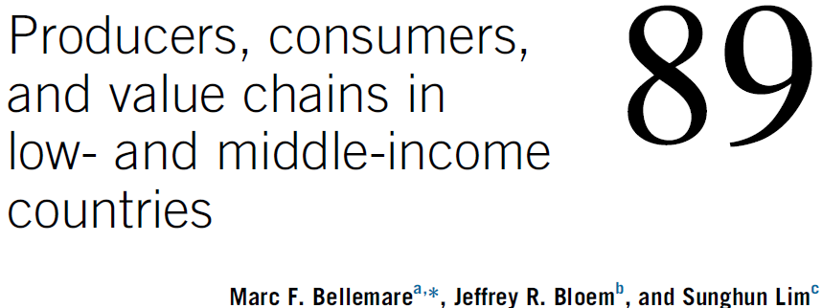
Key data gaps - 1
Pressing AFS issues demand data collection innovations to fill gaps.
One key gap concerns the ag value chain b/c post-farmgate accounts for >70% of value add in consumer food expenditures (& growing).
Source: Yi et al. (Nature Food 2021)
Central problem: AVC spans informal hh-based enterprises and formal non-hh firms. How to integrate?

Slide 8
Key data gaps - 2
The AVC is among the largest employers in most countries. Today we have negligible systematic tracking of jobs, compensation, and occupational hazards through AVC. This is important to promote fair trade certification and inclusive livelihoods development.
Source: Davis et al. (FAO 2023)

Slide 9
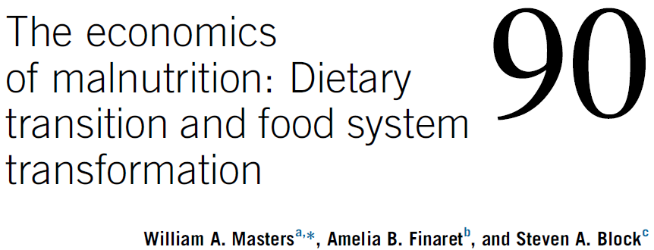
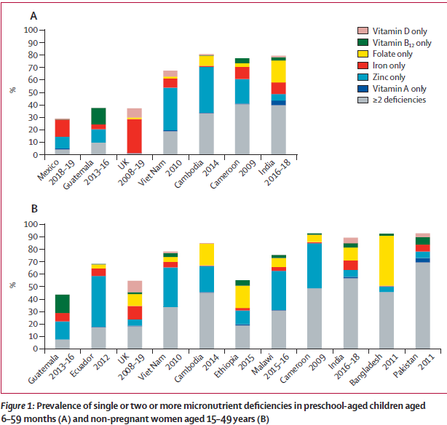
Key data gaps - 3
Dietary change is rapid. Some is healthful, some not. It remains difficult to track downstream health and nutritional value of diets, especially the complex of micronutrient deficiencies that are the world’s most prevalent source of diet-related health problems.
Stevens et al. Lancet Global Health 2022

Slide 10
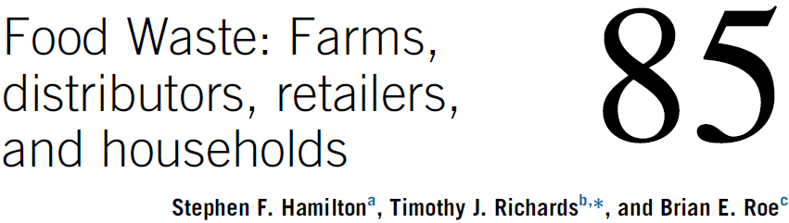
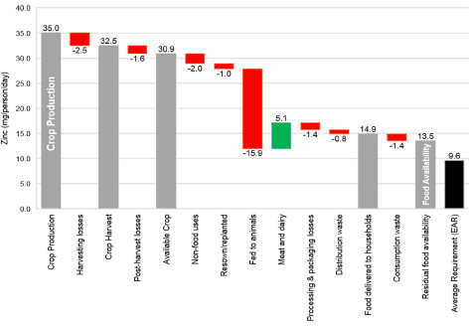
Key data gaps - 4
Food loss and waste notoriously difficult to track accurately. FL&W is highly decentralized and moves inversely with food prices. Closely related to challenges of tracking micronutrient intake.
Source: Ritchie et al. 2018 FSFS

Slide 11
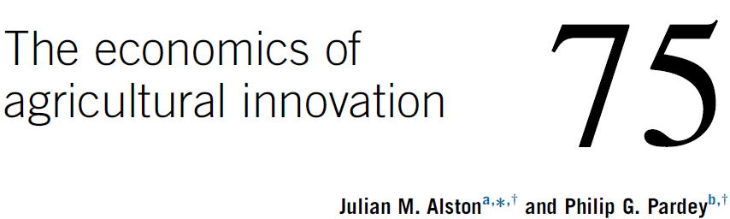
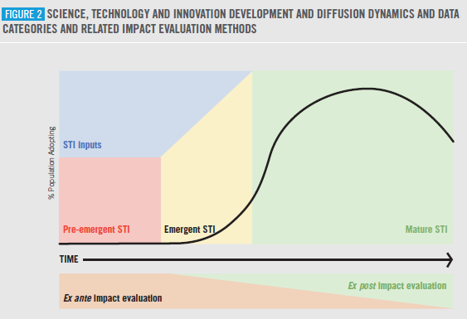

Key data gaps - 5
Science, technology and innovations (STI) drive productivity growth and enable rising standards of living within planetary boundaries. Yet, we remain poor at tracking innovations.

Slide 12
Key data gaps - 6
Most statistics are inherently backward looking but policy innately forward-looking. How to balance (expensive, slow) collection of survey and other ground-truthing data with use (cheap, fast) remotely sensed data, especially for nowcasting and forecasting?
Recognize all data suffer measurement error (mostly NCME).
Keep the purpose in mind: e.g., targeting vs. mapping.
Transparency, replicability, usability by implementers matters.
Beware atheoretical empiricism.
Celebrate both careful descriptive and rigorous causal analysis.

Slide 13
Conclusion
Agricultural statistics and agricultural economics are both enjoying great progress in recent years.
Each community has much to learn from the other and great opportunities exist to close data gaps to inform policymaking.
Thank you for your time, interest and comments!

